Slide 1
OPTIMAL Marketing Portfolio Strategy
15.093 : Julia Schwartz and Sanya Chauhan

Slide 2
Table of Contents
01
02
03
04
05
Data
Methods
Problem Statement
Key Findings
Why it Matters

Slide 3
Problem Statement
Optimize a marketing portfolio given a budget and four marketing options:
Targeted Online, Print, Email, Influencer
What different ways can this problem be formulated?
What different constraints could be added to the model?
When would these constraints be used?
What extensions exist for this question and framework?
When are these extensions relevant?

Slide 4
Data Description
Targeted Online Advertising
Investment Amount
Email Marketing
People
Reached (Views)
Print Media
Influencer Marketing
Sales (Buys)

Slide 5
Methods
Optimal Views Model
Optimal Sales Model
MIO Formulations
Formulate and solve model to optimize for marketing views given various budgets
Formulate and solve model to optimize for product Sales given various budgets
Use MIO to model the decision of having to onboard to an agency and pay a fixed fee to market
Additional Constraints
Dual Interpretation
Explore Extensions
Fixed allocation constraint
Balanced portfolio constraint
If, then constraint
Explore the value and interpretation of the dual in our project
Multi-Objective formulation for both buys and views
Time indexed model
Region indexed model

Slide 6
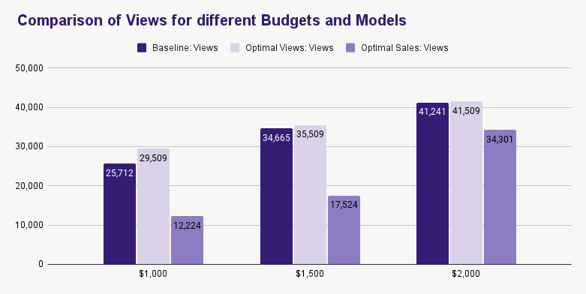
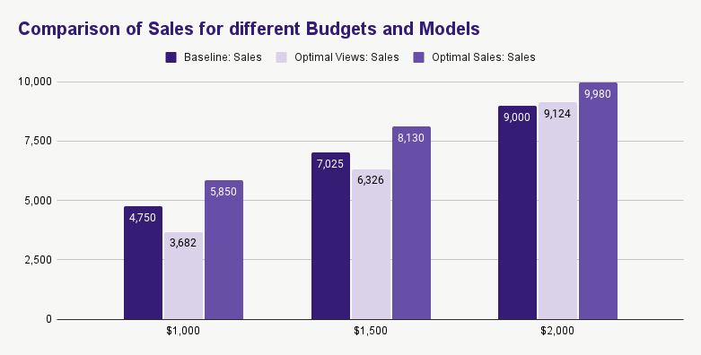
Key Findings
Budget | Baseline: Views | Baseline: Sales | Optimal Views: Views | Optimal Views: Sales | Optimal Sales: Views | Optimal Sales: Sales
$1000 | 25,712 | 4,750 | 29,509 | 3,682 | 12,224 | 5,850
$1500 | 34,665 | 7,025 | 35,509 | 6,326 | 17,524 | 8,130
$2000 | 41,241 | 9,000 | 41,509 | 9,124 | 34,301 | 9,980
Significant improvements from baseline in both sales and views maximization models
Marketing executives should make different decisions based on weather they would like to optimize views or sales
Email was very successful at optimizing views, email spend was maxed out at all budget constraints when optimizing views
Targeted online advertising and Influencers were most effective at optimizing sales.

Slide 7
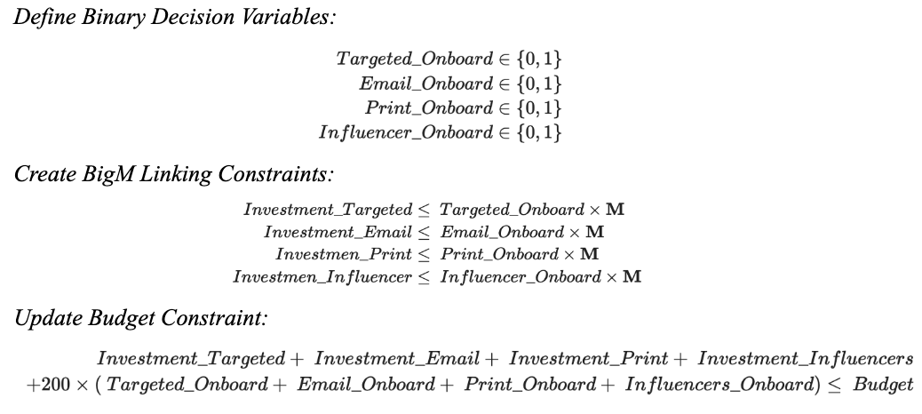
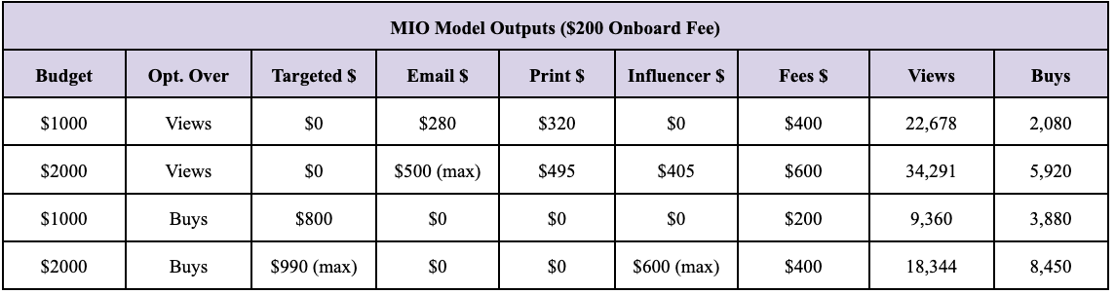
Mixed Integer Optimization

Slide 8
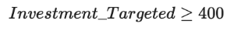
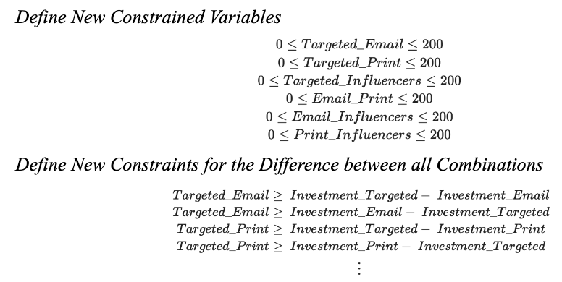
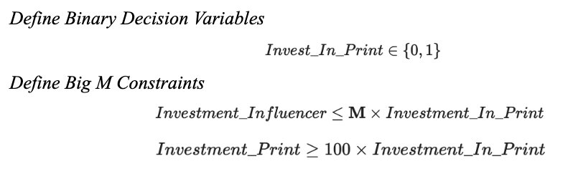
Additional Constraints
Fixed Allocation Constraint
Balanced Portfolio Constraint
If-then Constraint

Slide 9
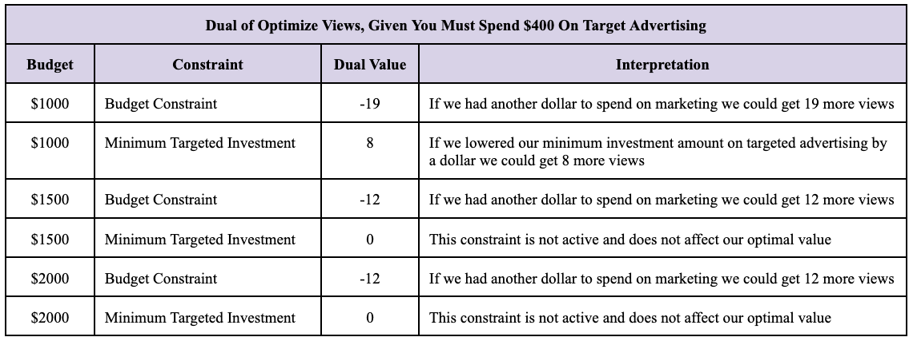
Dual Interpretation

Slide 10
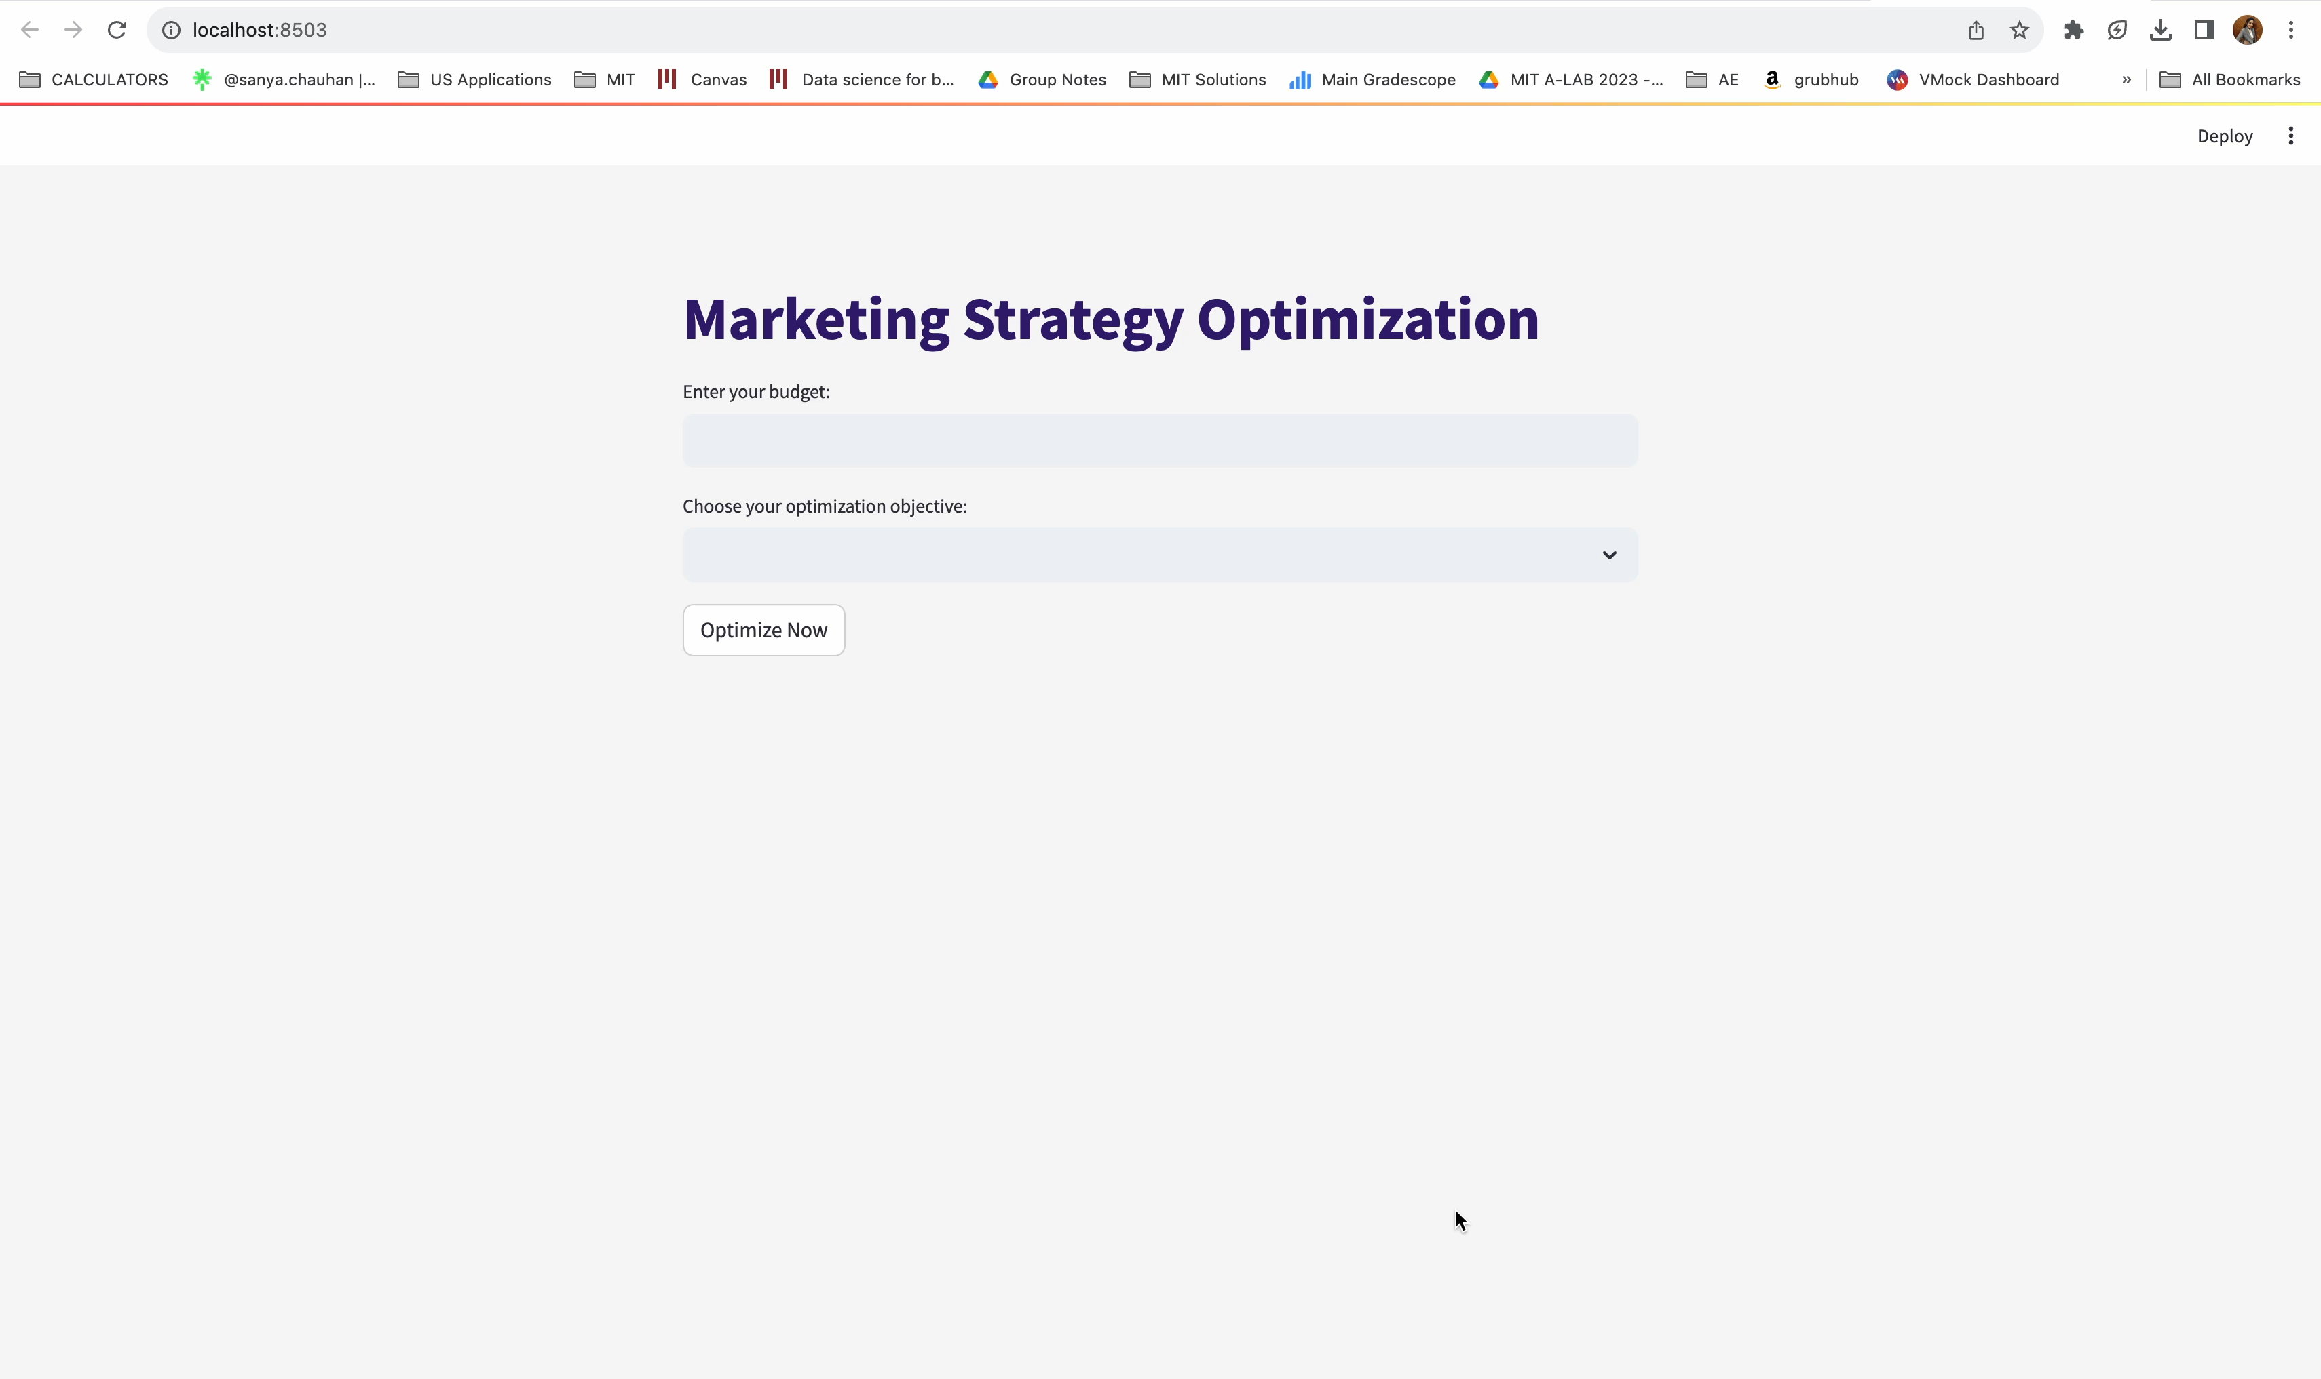

Slide 11
Why is it Important?
Customizable
Data-Driven Decision Making
User can choose preferred objective
Enhances decision precision, hence, better reach and sales
Marketing makes up
13.6%*
of companies Annual Spend
Adaptable & Scalable
Efficient Resource Allocation
Can be extended for any marketing strategies
Essential especially for SMEs
* Deloitte 2023 CMO Survey

Slide 12



THANK YOU FOR LISTENING!
JULIA SCHWARTZ
SANYA CHAUHAN
juliars@mit.edu
sanya14@mit.edu

